Slide 1
Games and Adversarial Search
Fundamentals of Artificial Intelligence
Slides are mostly adapted from AIMA, MIT Open Courseware and
Svetlana Lazebnik (UIUC)

Slide 2
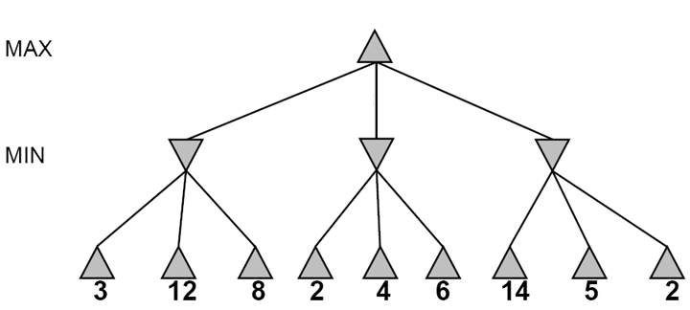
Alpha-beta pruning
It is possible to compute the exact minimax decision without expanding every node in the game tree
Notes:
Minimax algorithm assumes that the program has time to search all the way to terminal states which is usually not practical
If the maximum depth of a tree is m, and there are b legal moves at each point. Then the time complexity of minimax
Algorithm is O(b^m)
The algorithm uses a depth first search, so its space requirements are only linear in m and b
But the time complexity is huge. Recall that in chess for example, branching factor is around 35, and the depth of the tree is around 100
Instead of going all the way to terminal states and using the utility function, the program should cut off the search earlier and apply a heuristic evaluation function to the leaves of the tree
We will see this later.
However, even if we implement a minimax search with a reasonable evaluation function for chess, with a regular computer our program will be able to look ahead only three or four ply and will play as a novice player. Note that average human players can make plans 6 or 8 ply ahead.

Slide 3

α-β pruning
MINIMAX-VALUE(root) = max(min(3,12,8), min(2,x,y), min(14,5,2))
= max(3,min(2,x,y),2)
= max(3,z,2) where z <=2
= 3
X
Y
Notes:
Fortunately it is possible to compute the compute the correct minimax decision without looking at every node in the search tree
Eliminating a branch of the tree without examining is called as pruning the search tree
The technique we will discuss is called as alpha beta pruning

Slide 4
Alpha-beta pruning
≥3
3
Notes:
Consider again the 2 ply game that we discussed
The search proceeds as before
A1 then A11 A 12 and A13
And the node under A1 gets minimax value 3, since MIN will choose the minimum value among 3 12 and 8
MAX knows at this point that he/she hopes to get greater than 3 at the other branches, otherwise at least he/she will be satisfied with this 3

Slide 5

Alpha-beta pruning
≥3
3
≤2
Notes:
Now we follow A2 and A21 which has value 2
At this point we realize that if MAX plays A2, MIN has the option of reaching a position worth 2 and some other options that are now unknown
In any case MIN will not choose a value which is larger than 2
Therefore we can say that move A2 is worth at most 2 to MAX
Since we already know that move A1 is worth 3, there is no point at looking further under A2
In other words we can prune the search tree at this point
Therefore we will not need to look at A22 and A23

Slide 6
Alpha-beta pruning
≥3
3
≤2
≤14
Notes:
Let’s now consider the third branch, that is A3
When we see A31 which is 14 we know that MAX will get at least 14 if he/she chooses to play A3.
However MIN has something to tell as well, and will not let MAX to get such a large value if there is any value which is less

Slide 7
Alpha-beta pruning
≥3
3
≤2
≤5
Notes:
So we have to search the other branches
And first check A32 which is 5
Still it is larger than the 3 which MAX already has, and we continue

Slide 8
Alpha-beta pruning
3
3
≤2
2
Notes:
However at the end the maximum value that MAX can get from playing A3 is 2
Therefore MAX will choose 3 from A1

Slide 9
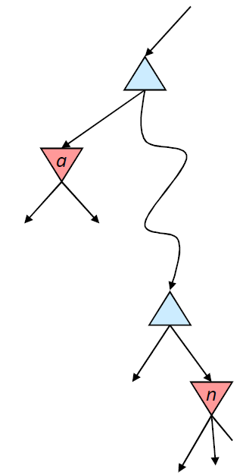

Alpha-beta pruning
α is the value of the best choice for the MAX player found so far
at any choice point above node n
We want to compute the
MIN-value at n
As we loop over n’s children,
the MIN-value decreases
If it drops below α, MAX will never choose n, so we can ignore n’s remaining children
Analogously, β is the value of the lowest-utility choice found so far for the MIN player
Notes:
The general principle is this:
Consider a node n somewhere in the tree
If player has a better choice either at the parent node of n or at any choice point further up,
Then n will never be reached in actual play
So once we have found out enough about n to reach this conclusion, we can prune it
Since minimax search is depth first, at any time we just have to consider the nodes along a single path in the tree

Slide 10
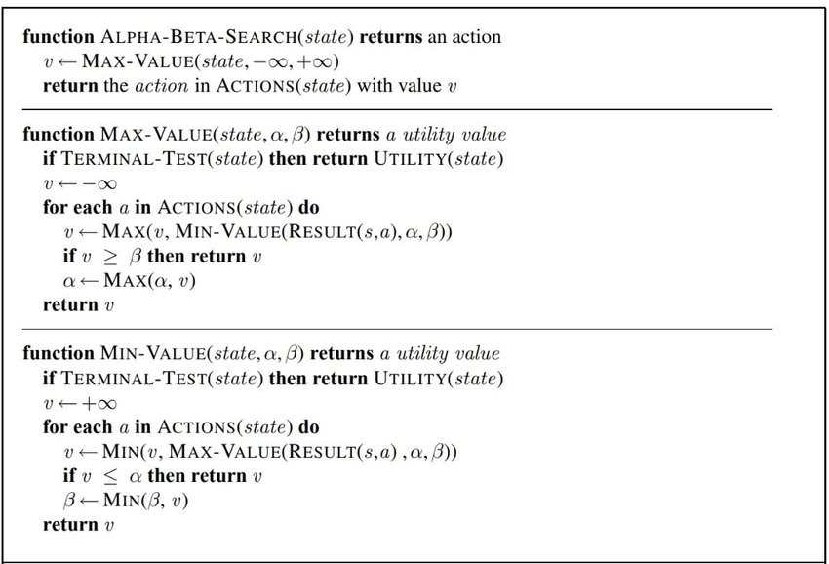
The α-β algorithm
Notes:
Let alpha be the value of the best choice we have found so far at any choice point along the path for MAX,
And beta be the value of the best (the lowest value) choice we have found so far at any point along the path for MIN
Alpha beta search updates the value of alpha and beta as it goes along , and prunes a subtree as it is known to be worse than the current alpha or beta

Slide 11
Alpha-beta pruning
Function action = Alpha-Beta-Search(node)
v = Max-Value(node, −∞, ∞)
return the action from node with value v
α: best alternative available to the Max player
β: best alternative available to the Min player
Function v = Max-Value(node, α, β)
if Terminal(node) return Utility(node)
v = −∞
for each action from node
v = Max(v, Min-Value(Succ(node, action), α, β))
if v ≥ β return v
α = Max(α, v)
end for
return v
node
action
…
Succ(node, action)
Notes:
Alpha is initially set to –infinity as the minimum value that MAX could get
And beta is initially set to +infinity as the maximum value MIN could get
Minimax aims to maximize the value for MAX and minimize the value for MIN
So that alpha and beta will be replaced with the best alternative values for MAX and MIN respectively
The algorithm is divided into MAX-VALUE and MIN-VALUE functions

Slide 12
Alpha-beta pruning
Function action = Alpha-Beta-Search(node)
v = Min-Value(node, −∞, ∞)
return the action from node with value v
α: best alternative available to the Max player
β: best alternative available to the Min player
Function v = Min-Value(node, α, β)
if Terminal(node) return Utility(node)
v = +∞
for each action from node
v = Min(v, Max-Value(Succ(node, action), α, β))
if v ≤ α return v
β = Min(β, v)
end for
return v
node
action
…
Succ(node, action)
Notes:
These apply to MAX and MIN nodes respectively, but each does the same thing
Return the minimax value of a node except for the nodes that are to be pruned

Slide 13
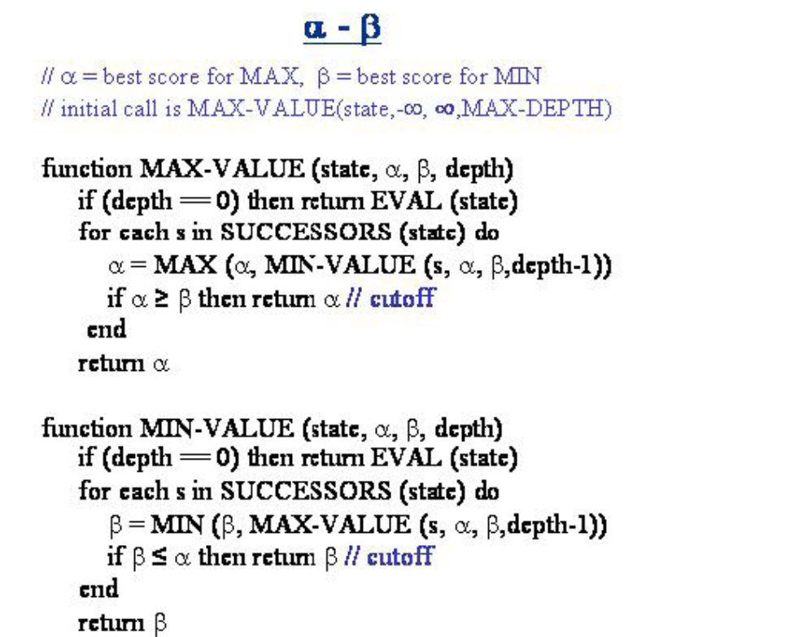
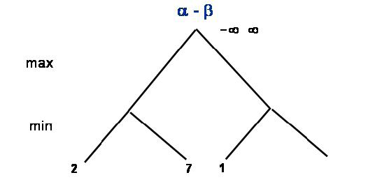
α-β pruning example
Notes:
Let’s run the algorithm on a simple example
Alpha is set to –infinity and beta is set to +infinity

Slide 14
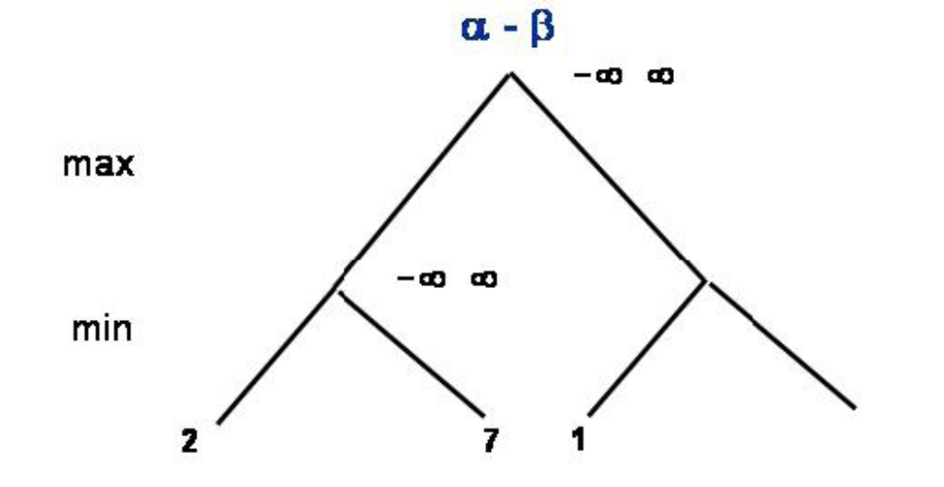
α-β pruning example
Notes:
We carry the values to A1

Slide 15
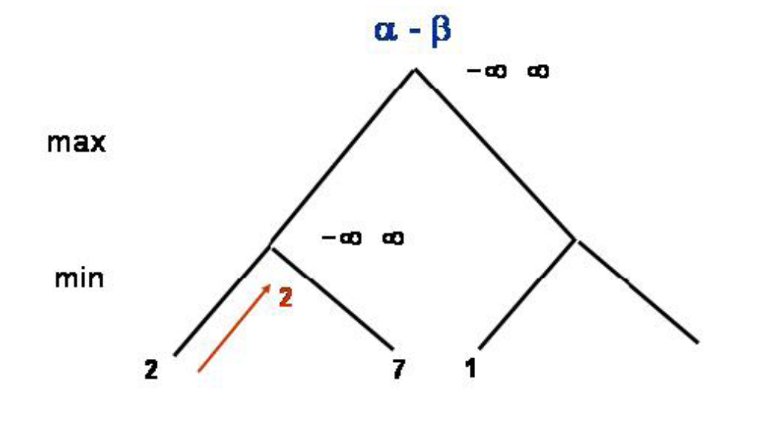
α-β pruning example
Notes:
Min has 2 on a11
We carry it to a1

Slide 16
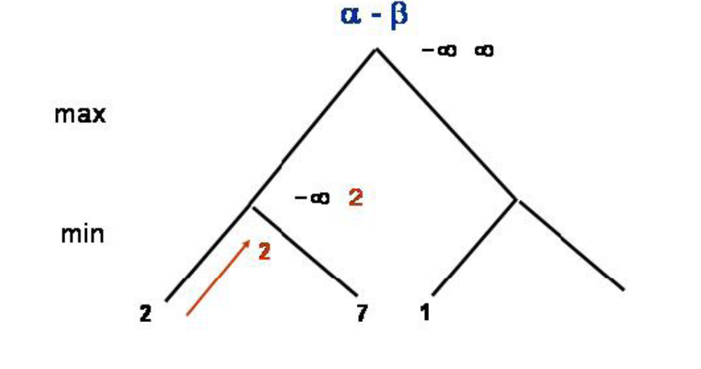
α-β pruning example
Notes:
Since it is min’s move
We use min-value function
We change beta with 2 which is smaller than +infinity
Since beta is not less than alpha there is no cutoff

Slide 17
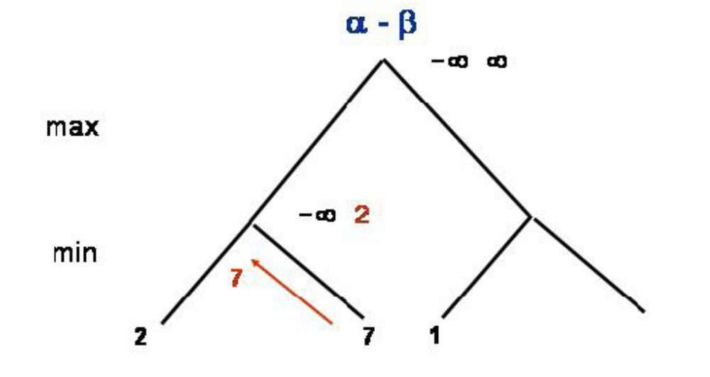
α-β pruning example
Notes:
Next we have 7

Slide 18
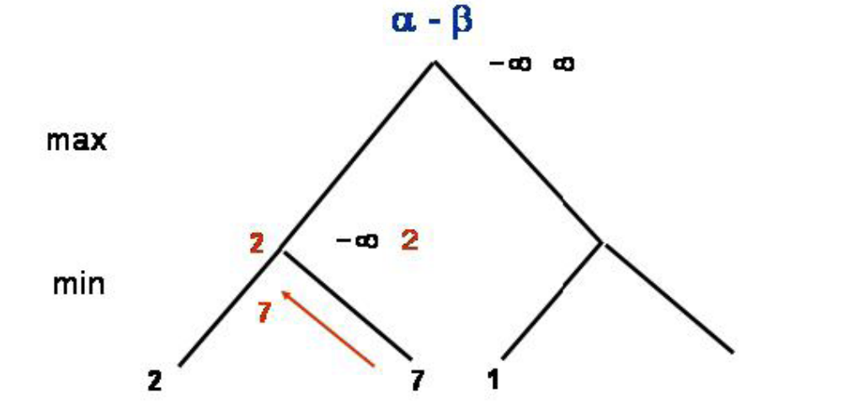
α-β pruning example
Notes:
Since 7 is not smaller than 2, beta stays the same
And there is no update on the value of A1

Slide 19
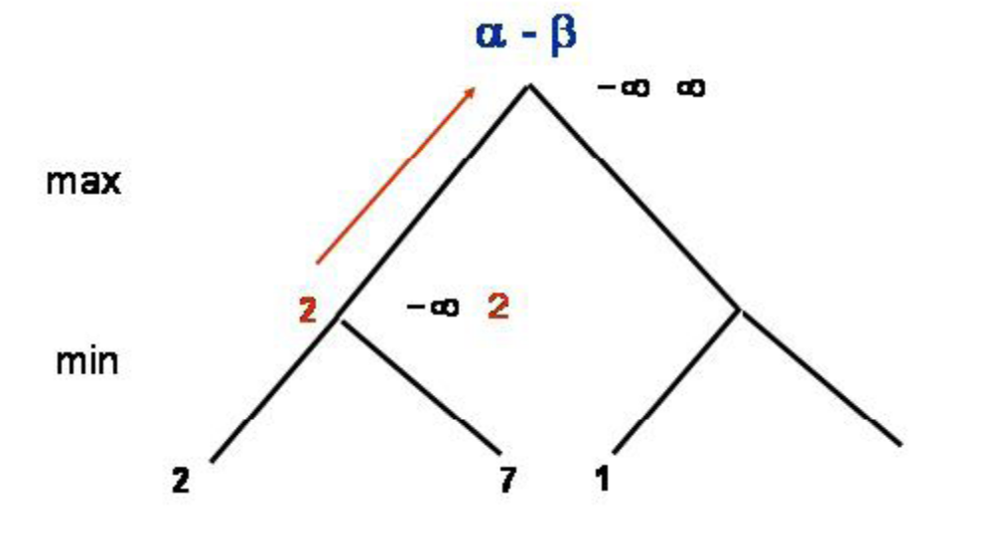
α-β pruning example
Notes:
So we carry 2 to the top

Slide 20
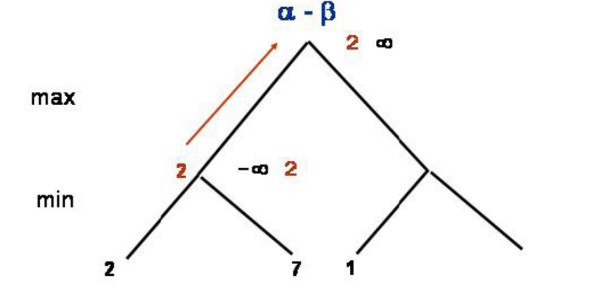
α-β pruning example
Notes:
Now it is max’s turn
2 is larger than current alpha which is –infinity
So we change alpha with 2

Slide 21
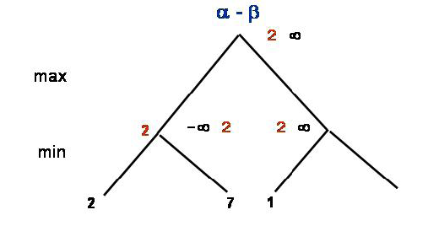
α-β pruning example
Notes:
On A2 branch now alpha is changed to 2 as well
And we expect to get something larger than 2

Slide 22
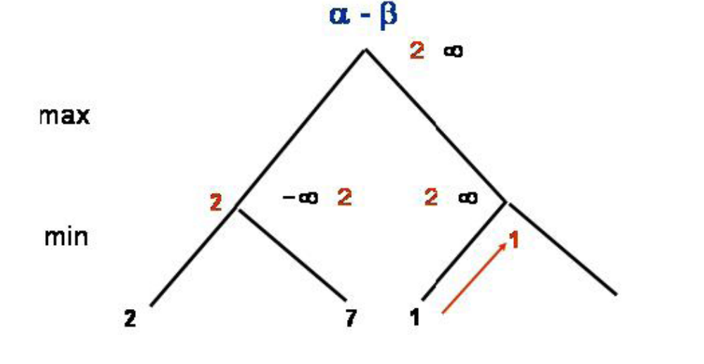
α-β pruning example
Notes:
We see 1 on A21, and carry it to A2

Slide 23
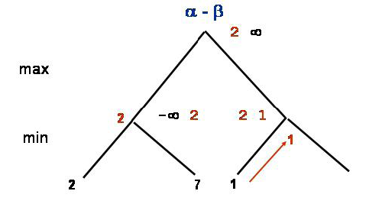
α-β pruning example
Notes:
1 is smaller than the current value of beta, so we change beta to 1

Slide 24
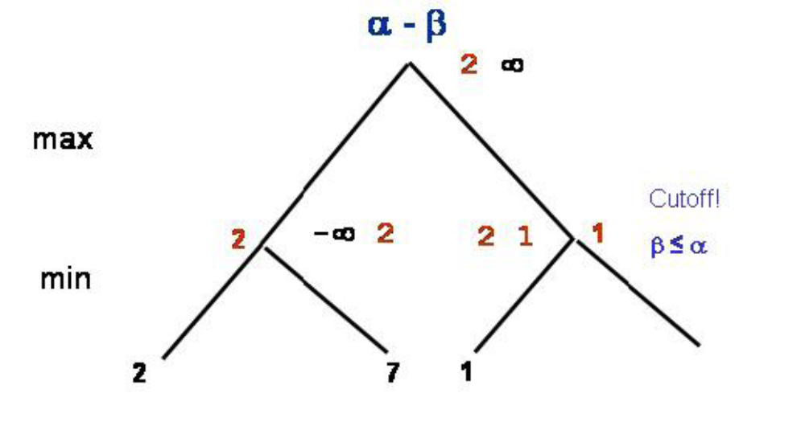
α-β pruning example
Notes:
At this point beta is les than alpha, so we have a cutoff

Slide 25
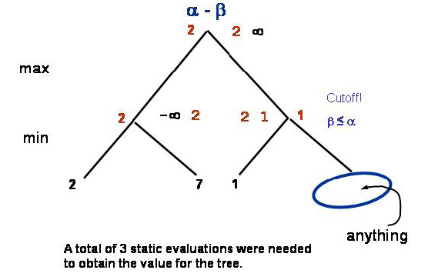
α-β pruning example
Notes:
The reason is that, on A2 MIN will allow at most 1, and this is already smaller than the value that MAX could get from A1,
And therefore there is no need to look more
Among 4 branches at the bottom, we cut of one, resulting in three evaluations instead of four

Slide 26
MAX
A
MIN
B
C
<=6
MAX
D
E
6
>=8
MIN
H
I
J
K
6
5
8
= agent
= opponent
Notes:
One more example
In this example, note that it is a 3 ply game, and therefore leaves correspond to the Min’s utilities.
So, we start with MAX’s choices.
From 6 and 5 , MAX will choose 6
And at node B, we will expect a value, which is less than 6. because if we see a smaller value MIN would prefer it
When we look at J we see that it is 8, so that at E, the minimum value that MAX would choose would be 8
This already larger than 6, but MIN will not allow 8 to be chosen
Therefore, we do not need to look at the value of K
So there is a cutoff here

Slide 27
MAX
>=6
A
MIN
B
C
6
<=2
MAX
D
E
F
G
6
>=8
2
MIN
H
I
J
K
L
M
H
I
6
5
8
2
1
= agent
= opponent
Notes:
We can now carry the value of A to B, and hope something greater than 6
On L and M we have 2 and 1 m so F would be 2
That means that the maximum value that MIN will allow at C would be 2.
We already have 6, and will not gain by looking further
Therefore we cut the right branch of C

Slide 28
MAX
>=6
A
MIN
B
C
6
2
MAX
D
E
F
G
6
>=8
2
H
I
H
I
J
K
L
M
MIN
6
5
8
2
1
= agent
= opponent

Slide 29
Alpha-beta Pruning
MAX
6
A
MIN
B
C
6
2
beta cutoff
MAX
D
E
F
G
6
>=8
alpha cutoff
2
H
I
H
I
J
K
L
M
MIN
6
5
8
2
1
= agent
= opponent
Notes:
As you see, we cut K, as well as G, and it’s two successors N and O
Therefore we cut 4 nodes
The cutoff at E was for MAX’s move, so we call it alpha cutoff
And the cutoff at C was for MIN’s move, so we call it beta cutoff

Slide 30
Properties of α-β
Pruning does not affect final result
Good move ordering improves effectiveness of pruning
With "perfect ordering," time complexity = O(b^{m/2})
  → doubles depth of search
A simple example of the value of reasoning about which computations are relevant (a form of metareasoning)

Slide 31
Alpha-beta pruning
Pruning does not affect final result
Amount of pruning depends on move ordering
  Should start with the “best” moves (highest-value for MAX or lowest-value for MIN)
  For chess, can try captures first, then threats, then forward moves, then backward moves
  Can also try to remember “killer moves” from other branches of the tree
With perfect ordering, the time to find the best move is reduced to O(b^{m/2}) from O(b^{m})
  Depth of search is effectively doubled
Notes:
As we have seen when applied to a standard minimax tree, alpha beta pruning returns the same move as minimax would
But prunes away branches that cannot possibly influence the final decision
The effectiveness of alpha beta depends on the ordering in which the successors are examined.
For example we couldn’t prune A31 and A32 in the first example but if we switch the leaves at that branch with ordering 2 5 and 14, we would again cut two nodes
What would happen if we could try to examine first the successors that are likely to be the best ?
In this case it turns out that alpha beta would examine only O(b^m/2) nodes to pick the best move instead of O(b^m)
This means that effective branching factor would be sqrt(b) instead of b,
For chess it would be six instead of 35
It means that alpha beta can look ahead twice as far as minimax for the same cost.
By thinking carefully about which computations actually affect the decision we are able to transfer a program from a novice into an expert

